Slide 1
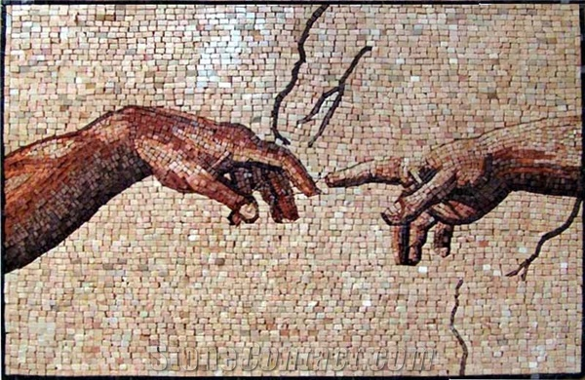
Asset Mapping
benefit,
Mosaic Ministries
February 17, 2018

Slide 2
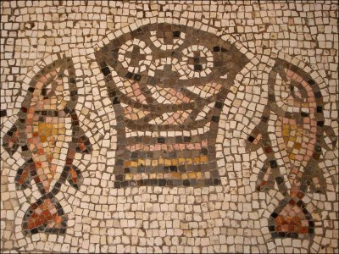
Devotional: Mark 6:30 - 44

Slide 3
Asset Mapping
At your table . . . share
What signs of God’s grace have you witnessed lately?
(in your church, in your community, or in your life)

Slide 4
Asset Mapping – A Beginning

Slide 5
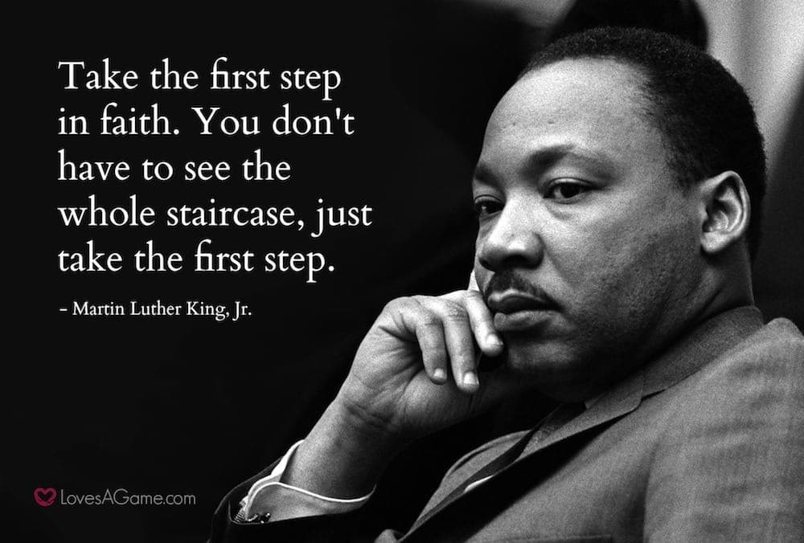

Slide 6
What is an Asset . . . Word association . . .
Resource . . .
Gifts . . .
Blessing . . .
Good point . . .
Strength . . .
Benefit . . .
Forte . . .
Virtue . . .
Boon . . .
Plus+

Slide 7
Physical
Individual
Network
Institutional
Economic
ASSETS

Slide 8
Asset Mapping Overview
Physical Assets: Things we can touch and see, land, equipment, spaces.
Individual Assets: Gifts, skills, experiences of individuals
Network Assets: Relational connections from formal associations to informal but regular group meetings.
Institutional Assets: Agencies, corporations, hospitals (for profit or not-for profit)
Economic Assets: Capacity to produce goods and services for money, foundations, endowments, corporations, micro-enterprise

Slide 9
Asset Mapping . . . Our First Step
Recognize Our Assets
Write down one asset in LARGE BLOCK LETTERS on a 3 x 5 card
Be specific (not “the building” but 100 seats in the sanctuary). Be creative.
Write down as many assets as you can think of personally in the next 10 minutes.

Slide 10
Asset Mapping Overview Reminder
Physical Assets: Things we can touch and see, land, equipment, spaces.
Individual Assets: Gifts, skills, experiences of individuals
Network Assets: Relational connections from formal associations to informal but regular group meetings.
Institutional Assets: Agencies, corporations, hospitals (for profit or not-for profit)
Economic Assets: Capacity to produce goods and services for money, foundations, endowments, corporations, micro-enterprise

Slide 11
Connect the Dots For Ministry to Young Adults
At your table spread out all the assets identified.
It is common to try to put assets together based on similarity. Do not do this!
Instead look for 4 or 5 assets that would seem to have no plausible connection to each other and brainstorm how these assets could be synergized for creative ministry to young adults 23-29.
“Goofy Synergies”
Have a scribe write down the different ideas that come.

